Slide 1
Osteo arthritis and soft tissue rheumatism
Dr.S.A.F.Kurukulasuriya

Slide 2

Osteoarthritis

Slide 3
Introduction
Disease of synovial joints.
Most common arthritis.
Classification I ry
II ry

Slide 4
Epidemiology
Prevelance increases with age.
Patients over 60 yrs have some radiological features world wide.
Radiological OA > Symptomatic OA

Slide 5
Aetiology
Active,at times inflammatory but potentially reparative process.
Spectrum of disease
Atrophic disease → hypertrophic disease
(Cartilage destruction) (new bone formation)

Slide 6
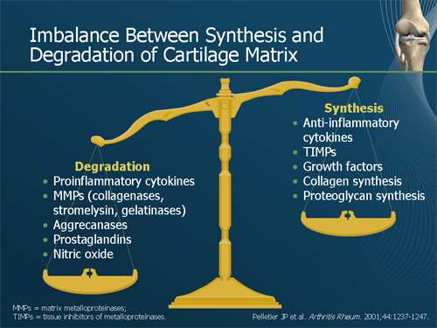

Slide 7
Contd…
Aetiological factors for 1ry OA
Age
Strong family tendency
Obesity
There is fibrillation →fissuring →eburnation

Slide 8
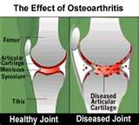

Slide 9
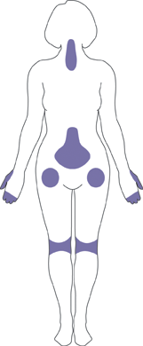
Clinical features
Acute pain– loss of ability and stiffness.
Range of motion reduced
Muscle spasm,contraction of the tendons.
Symptoms increase in the humid cold weather.
Commonly affects large weight bearing joints-HJ and the KJ.
Hands,feet and spine may be affected.
Muscle wasting

Slide 10
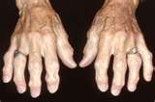
Clinical features contd…..
DIP involvement(Heberdens nodes)
PIP involvement (Bouchards nodes)
Toes involved (bunions)

Slide 11
II ry osteoarthritis
Injury
Septic arthritis
Diabetes mellitus
Marfans syndrome
Obesity
Alkaptonurea
Haemachromatosis

Slide 12
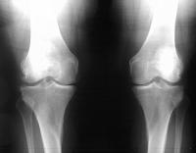
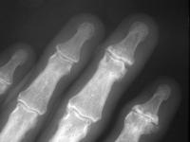
Diagnosis
Clinical examination would usually suffice.
Imaging- If surgery is contemplated/ suspect osteonecrosis
X-Ray changes
Loss of cartilage
Subchondral sclerosis
Subchondral cysts
Osteophytes

Slide 13
Treatment of osteoarthritis
Patient education
Life style factor modification
Medications
Surgery
Support groups

Slide 14
Life style factors
Weight control
Rest in acute disease
Moderate exercise,low impact activities- walking,swimming
Local heat before and cold packs after exercise
Appliances-walkers,knee bracers

Slide 15
Patient education
On nature of disease
Helps to reduce pain and stiffness, need for medication and improve function.

Slide 16
Medication
Paracetamol
NSAIDS-oral/local (transfasome carrier)
Corticosteroids-intra articular
Codeine,morphine in severe pain

Slide 17
Surgery
Fragment removal
Repositioning bone
Fusing bones
Joint replacement
Arthroscopy- no better than placebo

Slide 18
NSAIDS
Inhibits formation of prostaglandins (which plays a role in inflammation and pain).
Side effects-
GI bleeding
Peptic ulcer disease
Cramps
Diarrhoea
Damage to articular cartilage (Diclofenac sodium)

Slide 19
Soft tissue rheumatism

Slide 20
Introduction
General term to describe pain caused by damage to ligaments and tendons rather than bone and cartilage.
Tennis elbow
Golfer’s elbow
Frozen shoulder
Plantar fasciitis
Prepatellar bursitis

Slide 21
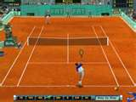
Tennis elbow

Slide 22
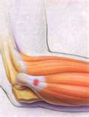
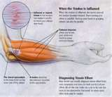
Introduction
Outer part of the elbow is sore and tender.
Associated with racquet sports.
Also known as lateral epicondylitis.- Misnomer.No inflammatory changes.

Slide 23
Signs and symptoms
Pain on the outer part of the elbow.
Point tenderness over the origin of the ECRB from the lateral epicondyle.
Wrist extention ,lifting movements,gripping hurts.
Pain with passive wrist flexion.
Pain with resisted extension of the wrist.-cozen’s sign.

Slide 24
Risk factors
Age – strongest.30-60 yrs.
Repititive movements such as tennis causes tiny tears of the forearm tendon.

Slide 25
Pathophysiology
Chronic degenerative changes of extensor carpi radialis brevis.
Non-inflammatory.

Slide 26
Diagnosis
On clinical signs and symptoms.
MRI- Fluid in the ECRB origin.

Slide 27
Treatment
NSAIDS.
Heat/ice.
Counter force brace (elbow strap).
Vibration therapy devices.
Reclariant cases→surgery (open/percutaneous/arthroscopic).
Corticosteroid injections-no efect.

Slide 28
Prevention
Progressive stretching to prevent re irritation of tendon.
Racquet players-advised to strengthen rotator cuff,scapulothoracic and abdominals to prevent over compensation at the wrist joint.

Slide 29
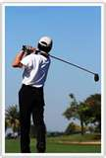
Golfer’s elbow

Slide 30
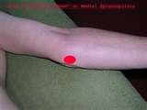
Introduction
Inflammation of the insertion of flexors of the fingers,thumb and the pronators of the wrist joint.
At the medial epicondyle.

Slide 31
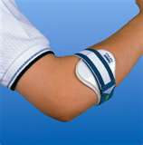
Treatment
NSAIDS.
Heat/ice.
Elbow strap.
Splint at 30-45 degrees of elbow flexion.
Physiotherapy
Definitive treatment- local coticosteroid injection.
Fails-epicondylar debriment surgery.

Slide 32
Frozen shoulder

Slide 33
Introduction
40-60 yrs
Females >Males
> troublesome in diabetics, recovery prolonged.

Slide 34
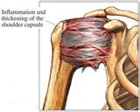
Pathology
Shoulder capsule inflamed and stiff.
Grows together with abnormal bands of tissue. →chronic pain.
Reduced synovial fluid.
Caused by
Injury
Idiopathic
Shoulder surgery

Slide 35
Symptoms
Movement of shoulder joint severely restricted(raising,external rotation).
Worse at night.
Dull/aching type pain.
Active and passive R.O.M. equal.

Slide 36
Risk factors
Diabetes mellitus
Stroke
Lung disease
Rheumatoid arthritis
Heart disease
HAART

Slide 37
Diagnosis
On clinical features.
MRI/arthrogram - confirm diagnosis

Slide 38
Treatment
Aim- Restoring joint movement and reduce shoulder pain
NSAIDS
Heat therapy
TENS
Series of steroid injections to shoulder joint
Unsuccessful→ Manipulation under anaesthesia
Surgery→capsular release

Slide 39
Plantar fasciitis

Slide 40
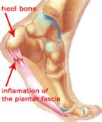
Introduction
The plantar fascia is a thick fibrous band from the bottom surface of the calcaneous towards the toes.
Painful inflammation of the plantar fascia.
Long standing→More inflammatory than degenerative.
10% of the population.

Slide 41
Risk factors
Long periods of standing.
Increased BMI.
Thin fat pad of the sole.

Slide 42
Diagnosis
Clinical examination would suffice.
Imaging→X-rays,ultra sound scan,MRI
Heel spur is an incidental finding.

Slide 43
Treatment
Foot supports,night splints.
NSAIDS.
Physiotherapy.
Corticosteroid injections-may be painful.
Surgery for refractory cases.

Slide 44
Prepatellar bursitis

Slide 45
Introduction
Common cause of swelling and pain above the patella.
Due to inflammation of the pre patellar bursa.
Aseptic/septic.
> in men.

Slide 46
Treatment
Aseptic- treat conservatively.
Complicated cases-NSAIDS/Corticosteroid injections.
Rarely need surgical excision.

